Slide 1

.

Slide 2
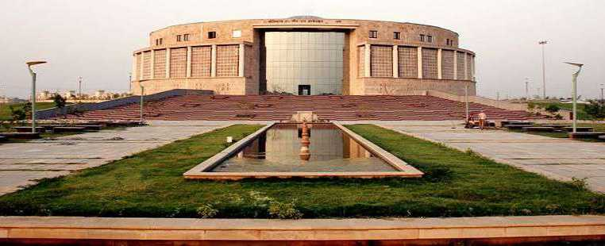
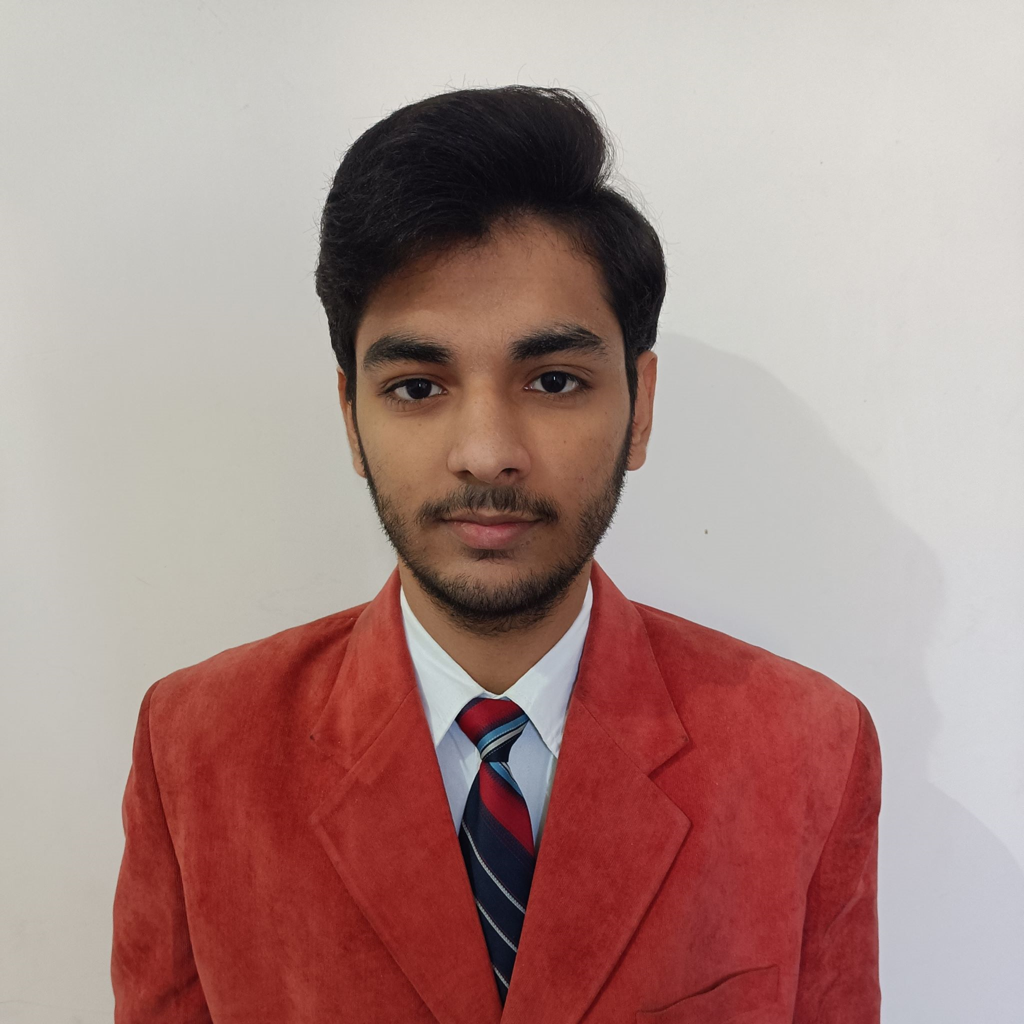
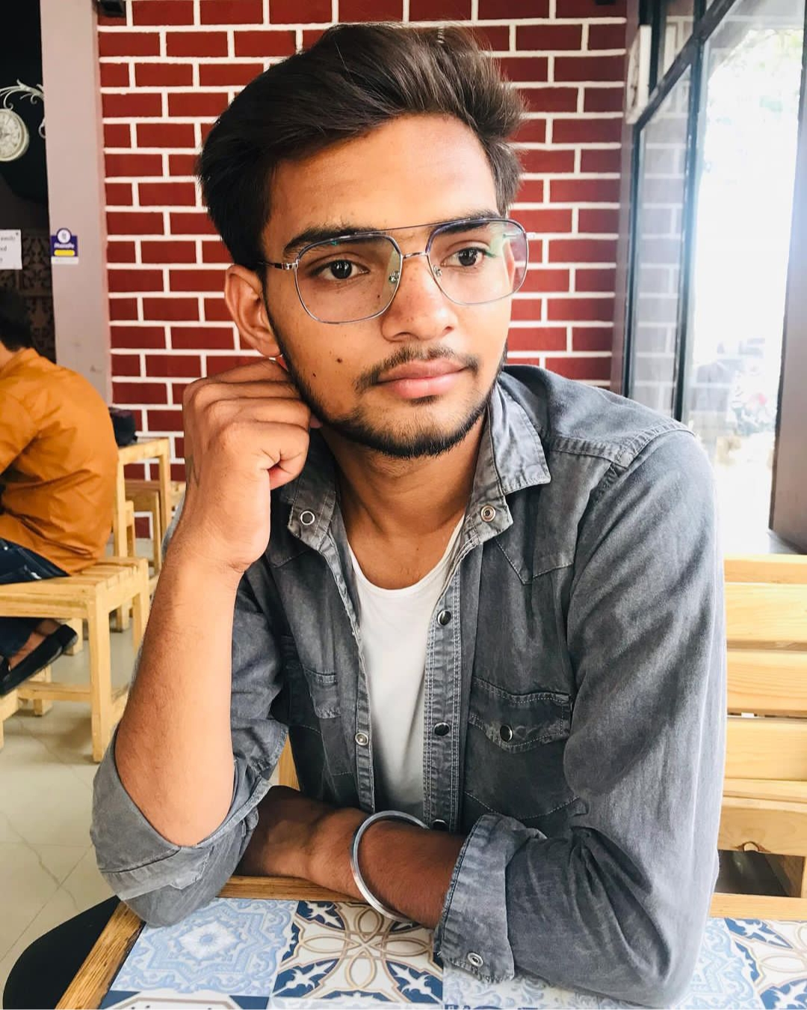
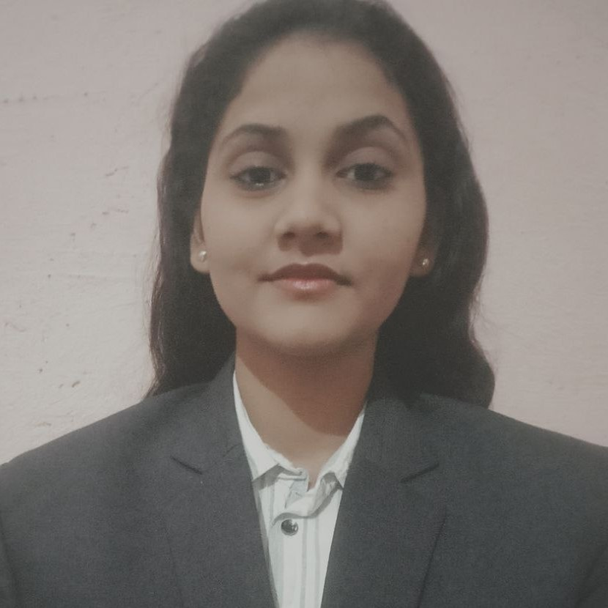
OUR TEAM
Sujal Chaudhary
Dilip Singh
Sarita Sharma
Web Developer
Lang. – HTML, CSS, JS, C, C++
Email – chsujalm@gmail.com
Web Developer
Lang. – HTML, CSS, JS, C, C++
Email – dr.dilipsinghg@gmail.com
Web Developer
Lang. – HTML, CSS, C, JS, C++
Email – saritasharma8201@gmail.com

Slide 3
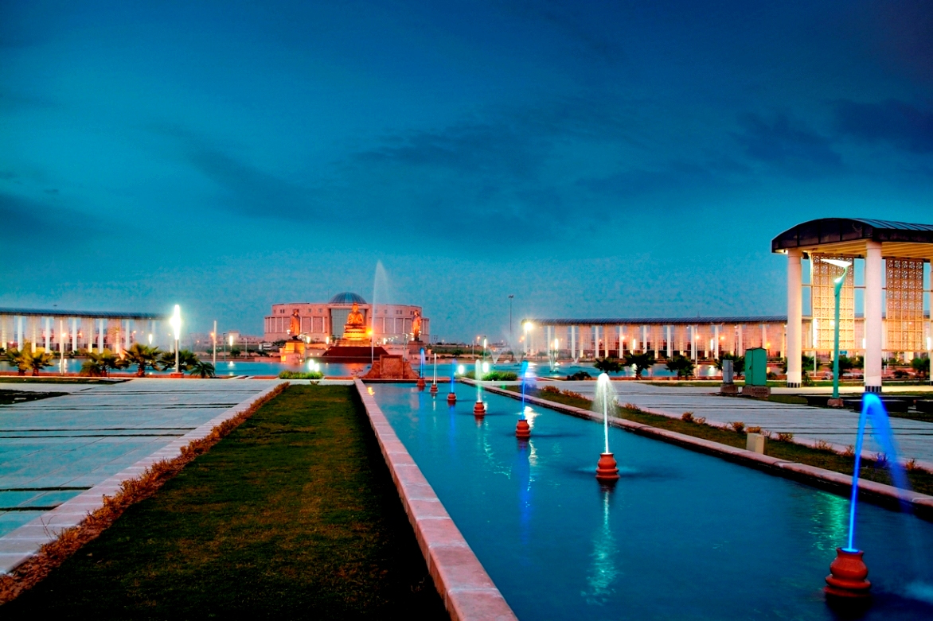
INTRODUCTION

Slide 4
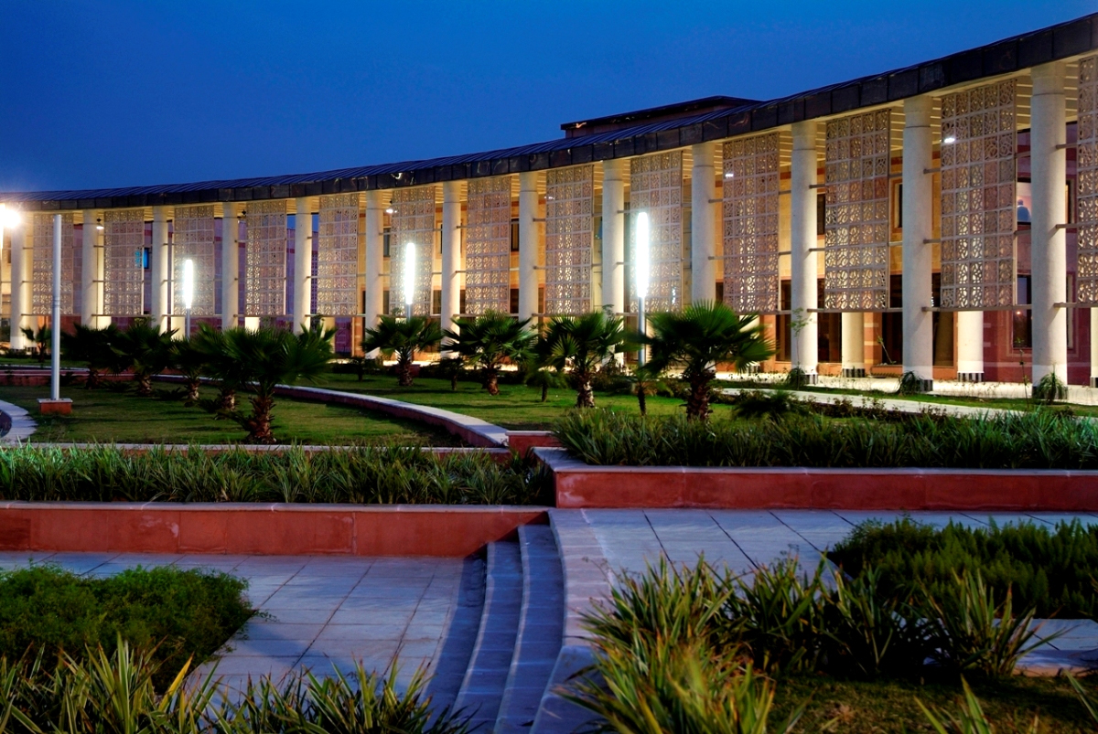
GBU E-ATTENDANCE SYSTEM IS A PORTAL FOR GATUAM BUDDHA UNIVERSITY FOR ONLINE ATTENDANCE …..

Slide 5
PROBLEM STATEMENT

Slide 6

DURING OUR EXAM TIME, WE FACED SO MUCH PROBLEMS REGADING TO THE ATTENDACE AS EVERYTHING WAS DONE IN OFFLINE MODE …….
USING THIS PORTAL IT’LL BE EASY FOR TEACHERS TO MARK STUDENT’S ATTENDANCE ONLINE AND STUDENTS CAN ALSO CHECK THEIR ATTENDANCE ON THE PORTAL ONLINE AT ANY TIME …..
IT’LL MAKE EVERYTHING EASY AND ALSO RDUCE PAPER WASTE…..

Slide 7
REQUIREMENT

Slide 8
HARDWARE – ANY SMARTPHONE, TABLET , PC/LAPTOP..
SOFTWARE – ANY WEB BROWSER ..

Slide 9
TECHNOLOGY USED
HTML
CSS
JAVASCRIPT
BOOTSTRAP

Slide 10
PROJECT DESCRIPTION

Slide 11
THERE ARE THREE DASHBOARDS ON THE WEBSITE – ADMIN , TEACHER & STUDENT DASHBOARD AND CAN BE ACCESSE BY ENTERING USERNAME & PASSWORD.
On student’s dashboard, student can check his/her profile and attendane & can update some details.
On teacher’s dashboard, teacher can take attendance of the class and can check attendance
On admin dashboard, admin will be able to access everything and can make some changes

Slide 12
SCOPE
THE SCOPE OF THIS PROJECT IS THAT IT’LL MAKE EVERYTHING EASY AND WILL SAVE TOO MUCH TIME
& MAKE TRANSPARENCY IN DATA SUBMISSION AND DATA CAN BE CHECKED ANYTIME BY THE USERS..

Slide 13
CHHALANGES FACED
THE MOST IMPORTANT CHHALANGE WE FACED WAS AT THE TIME OF BACKEND AND DATABASE & WE’RE STRUGGLING AT THIS STAGE TILL NOW ..

Slide 14
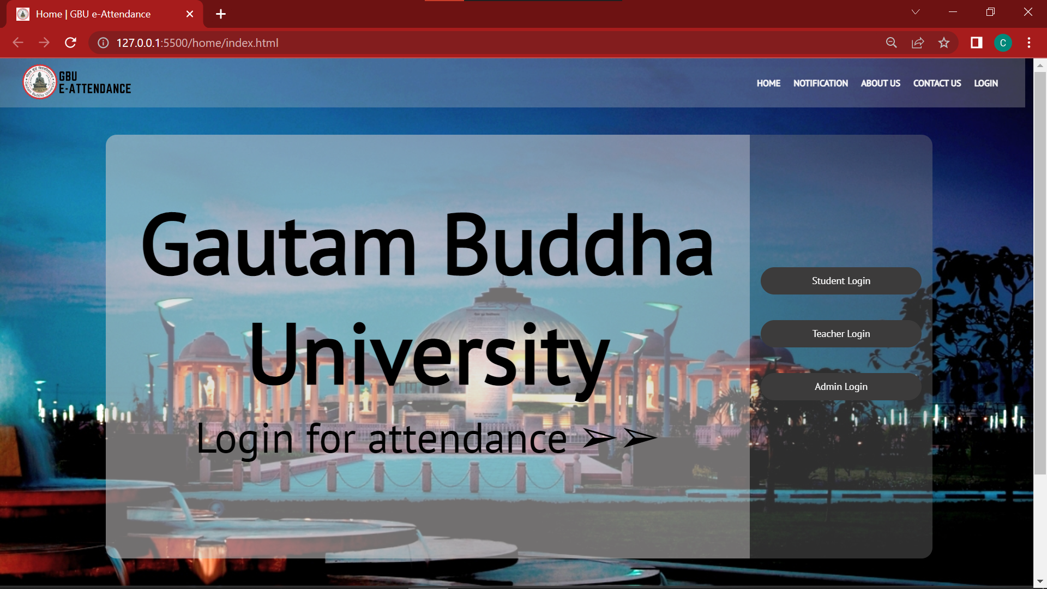
HOMEPAGE

Slide 15
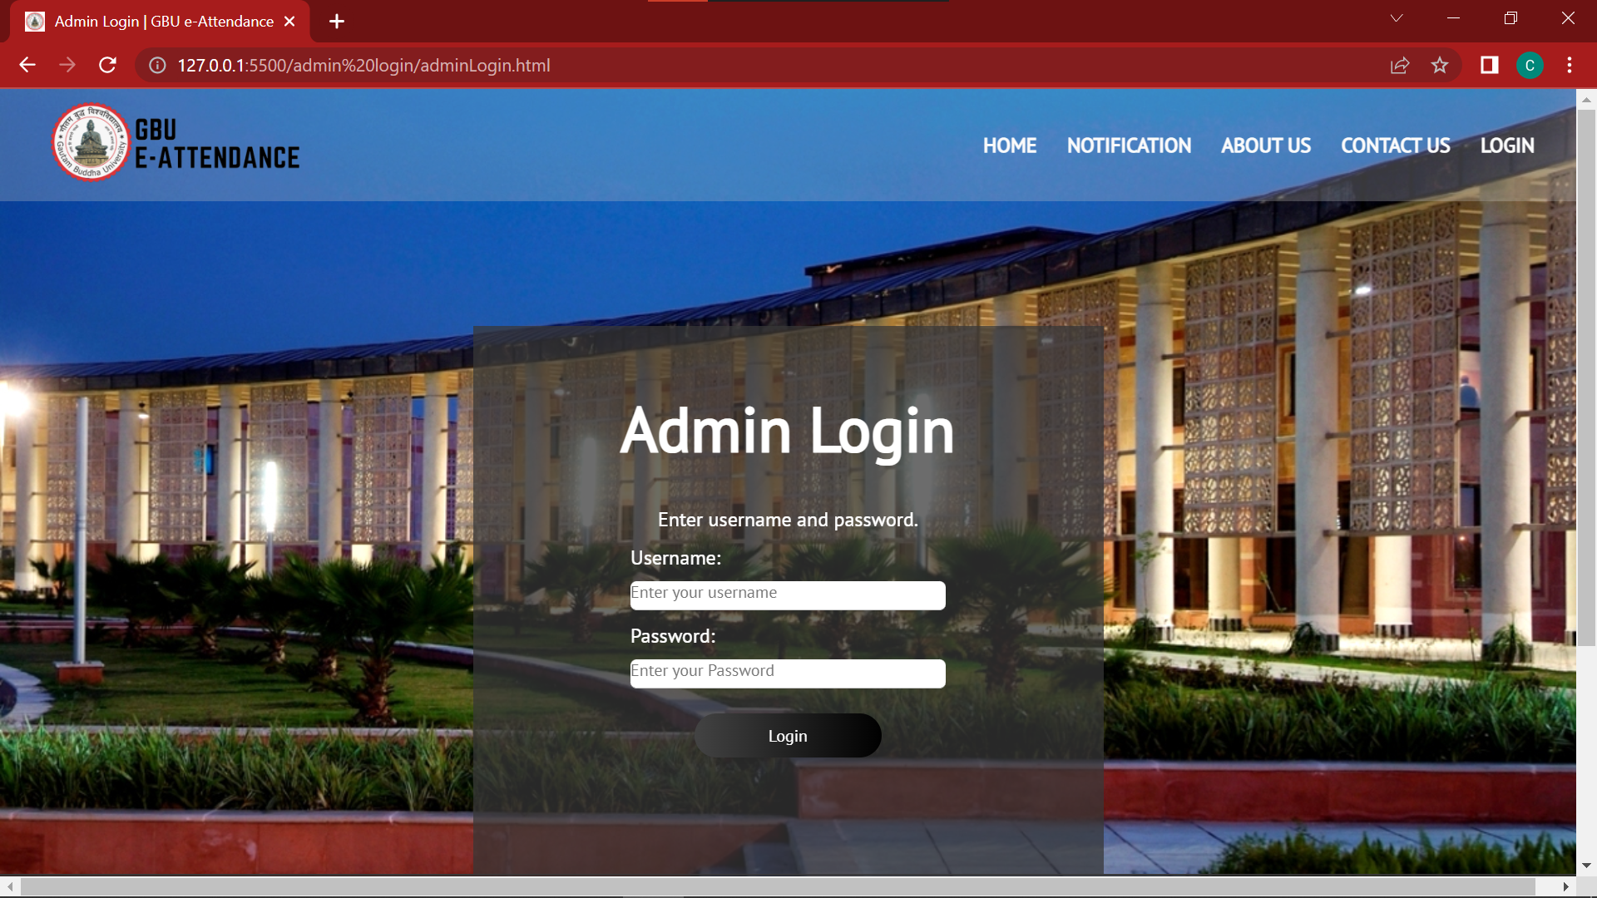
LOGIN PAGE

Slide 16
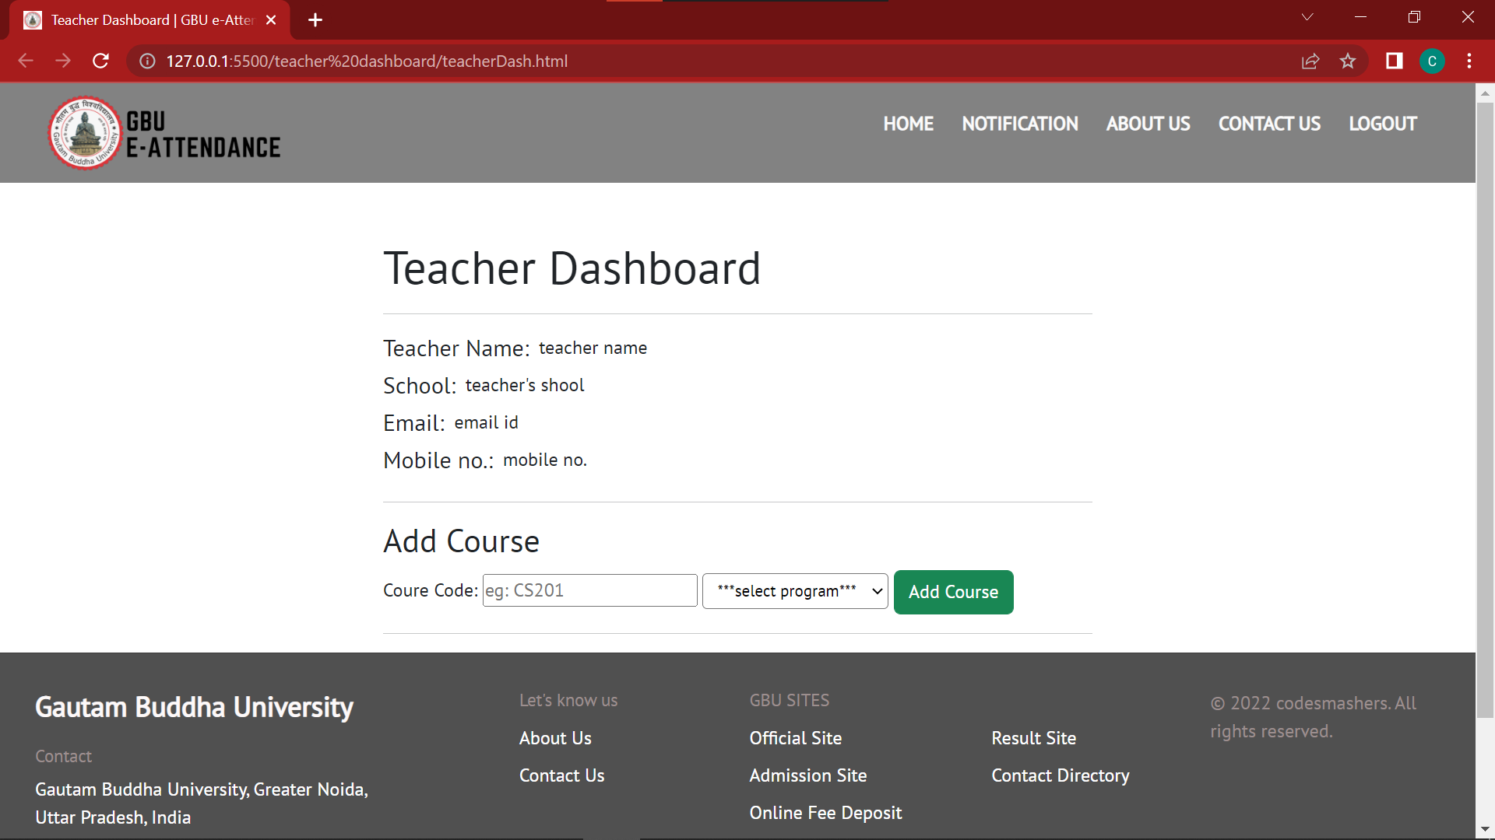
DASHBOARD

Slide 17
CONCLUSION
THE CONCLUSION IS THAT THE FRONTEND PART OF THE PROJECT IS COMPLETED & BACKEND PART IS UNDER PROCESS. IT’LL BE COMPLETED AS SOON AS POSSIBLE.

Slide 18
THANK YOU
- CODE SMASHERS

